Slide 1

Data Flow Diagram (DFD)
A Data Flow Diagram (DFD) is a graphical representation of the "flow" of data through an information system, modeling its process aspects.

Slide 2
Examples of LCs
Data Flow Diagrams can be used in both Analysis and Design phase of the SDLC.
DFDs are attractive technique because they provide what users do rather than what computers do.

Slide 3
DFDs only involve four symbols.
Entity
Process
Data store
Data flow

Slide 4
Descriptions of Symbols:
 external entity - people or organisations that send data into the system or receive data from the system.
 process - models what happens to the data
i.e. transforms incoming data into outgoing data.
 data store - represents permanent data that is used by the system.
 data flow - models the actual flow of the data between the other elements.

Slide 5
Symbol naming
 External Entity → Noun
 Data Flow → Names of data
Process → verb phrase
 Data Store → Noun

Slide 6
The Levels
Levels Description
Explanation
Contains only one process
Level 0 Context diagram
Level 1 Overview diagram
Utilizes all four elements
A breakdown of a level 2 process
Level 2
Detailed diagram
There is no rule as to how many levels of DFD that can be used.

Slide 7
A Context Diagram (Level 0)
 The major information flows between the
entities and the system.
 A Context Diagram addresses only one
process.

Slide 8
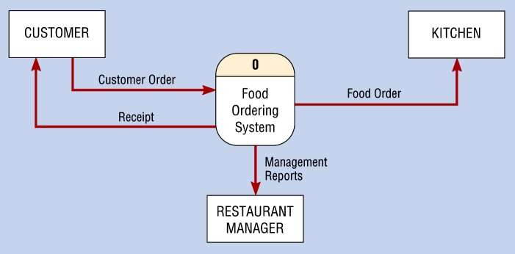
Rules for Level 0 Diagram :
 1 process represents the entire system.
 Data arrows show input and output.
 Data Stores NOT shown. They are
system.
within the

Slide 9
Rules for Level 1 Diagram :
 Level 1 DFD, must balance with the context diagram it describes.
 Input going into a process are different from outputs leaving the process.
 Data stores are first shown at this level.

Slide 10
Rules for Level 2 Diagram :
 Level 2 DFD must balance with the Level 1 it describes.
 Input going into a process are different from outputs leaving the process.
 Continue to show data stores.

Slide 11
Numbering
 On level 1 processes are numbered 1,2,3…
 On level 2 processes are numbered x.1, x.2, x.3… where x is the number of the parent level 1 process.
 Number is used to uniquely identify process not
to represent any order of processing
 Data store numbers usually D1, D2, D3...

Slide 12
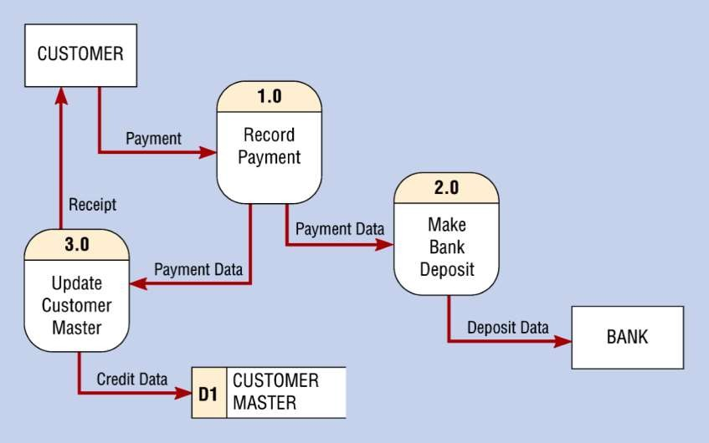
DFD Example

Slide 13
Common Rules :
All processes must have at least one data flow in and one data flow out.
All processes should modify the incoming data, producing new forms of outgoing data.
Each data store must be involved with at least
one data flow.
Each external entity must be involved with at least one data flow.
A data flow must be attached to at least one process.
6. In DFDs, all arrows must be labeled.

Slide 14
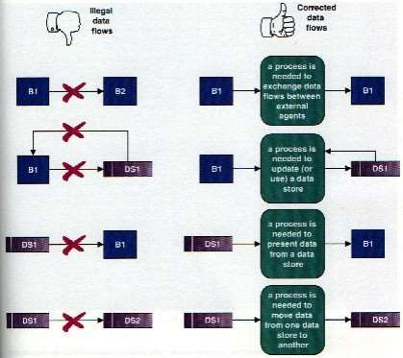
Common errors in DFD

